Slide 1
CISC3003 Individual project
DC227620 PO HIU LAM

Slide 2
Table of contents
01
INTRODUCTION
Demo
02
SERVICES
03
IMPORTANT TECHNIQUE
04

Slide 3
INTRODUCTION
Shopping website
Use in the phone or computer
Intuitive user interface

Slide 4
SERVICES
Upload product
Buy
Users could upload their things as products to sell on the website
User could buy anything their want on this webpage. Also, they can track the progress of delivery.

Slide 5
SERVICES
Devices
Feedback
The website provides flexibility that allows user to open the website in other devices
For each buttons, there is an alert to return feedback for users to have good interactions.

Slide 6
IMPORTANT TECHNIQUE
PHP
JavaScript
MySQL
HTML/CSS
Dynamic website, update the data for users to have interaction
Allow the button open and close
Store the data
Provide good webpage design and structure

Slide 7
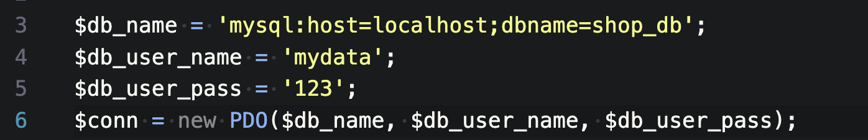
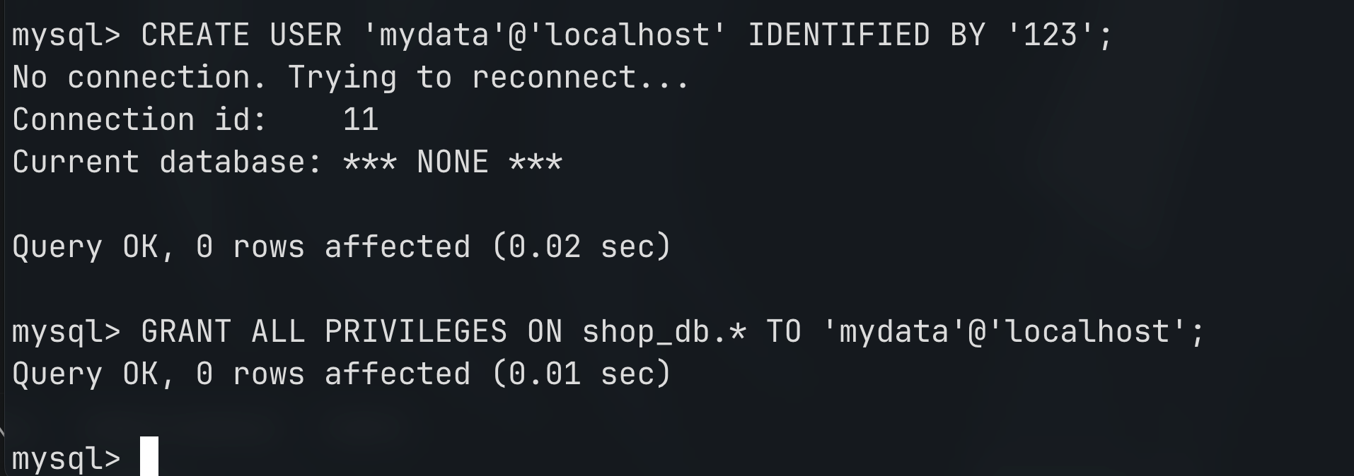
MySQL + PHP
user name and password
create user and grant privilege
Using command line to interact with MySQL. This process includes:
Create user
Grant privilege
Connect between database and webpage
Insert and delete data from webpage

Slide 8
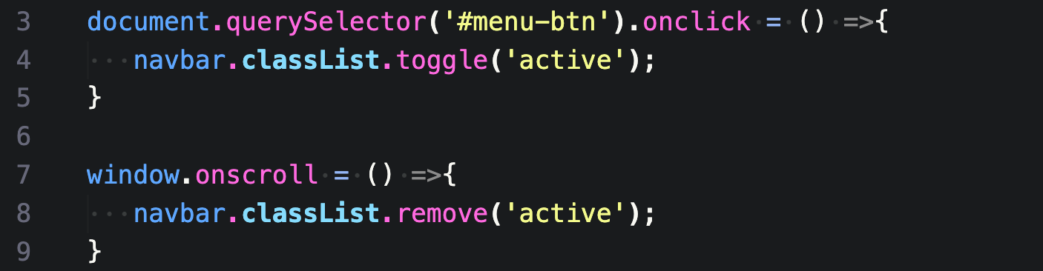
JavaScript
Change the behavior of the menu button such that it can open and close when users click it. Moreover, it closes automatically when scrolling the page

Slide 9
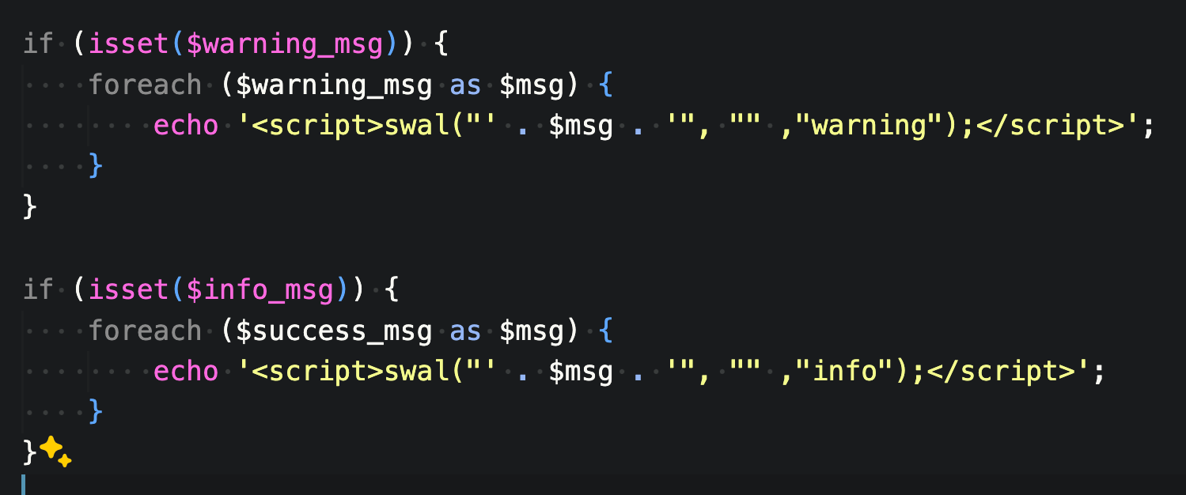
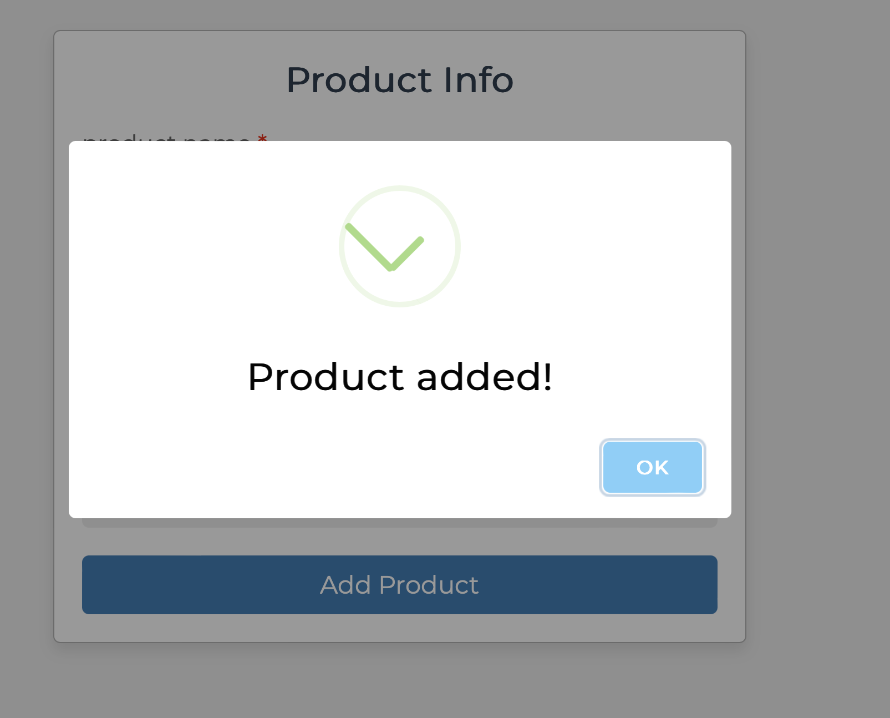
JS + PHP
PHP is available to interact with JavaScript by outputting it using ‘echo’.

Slide 10
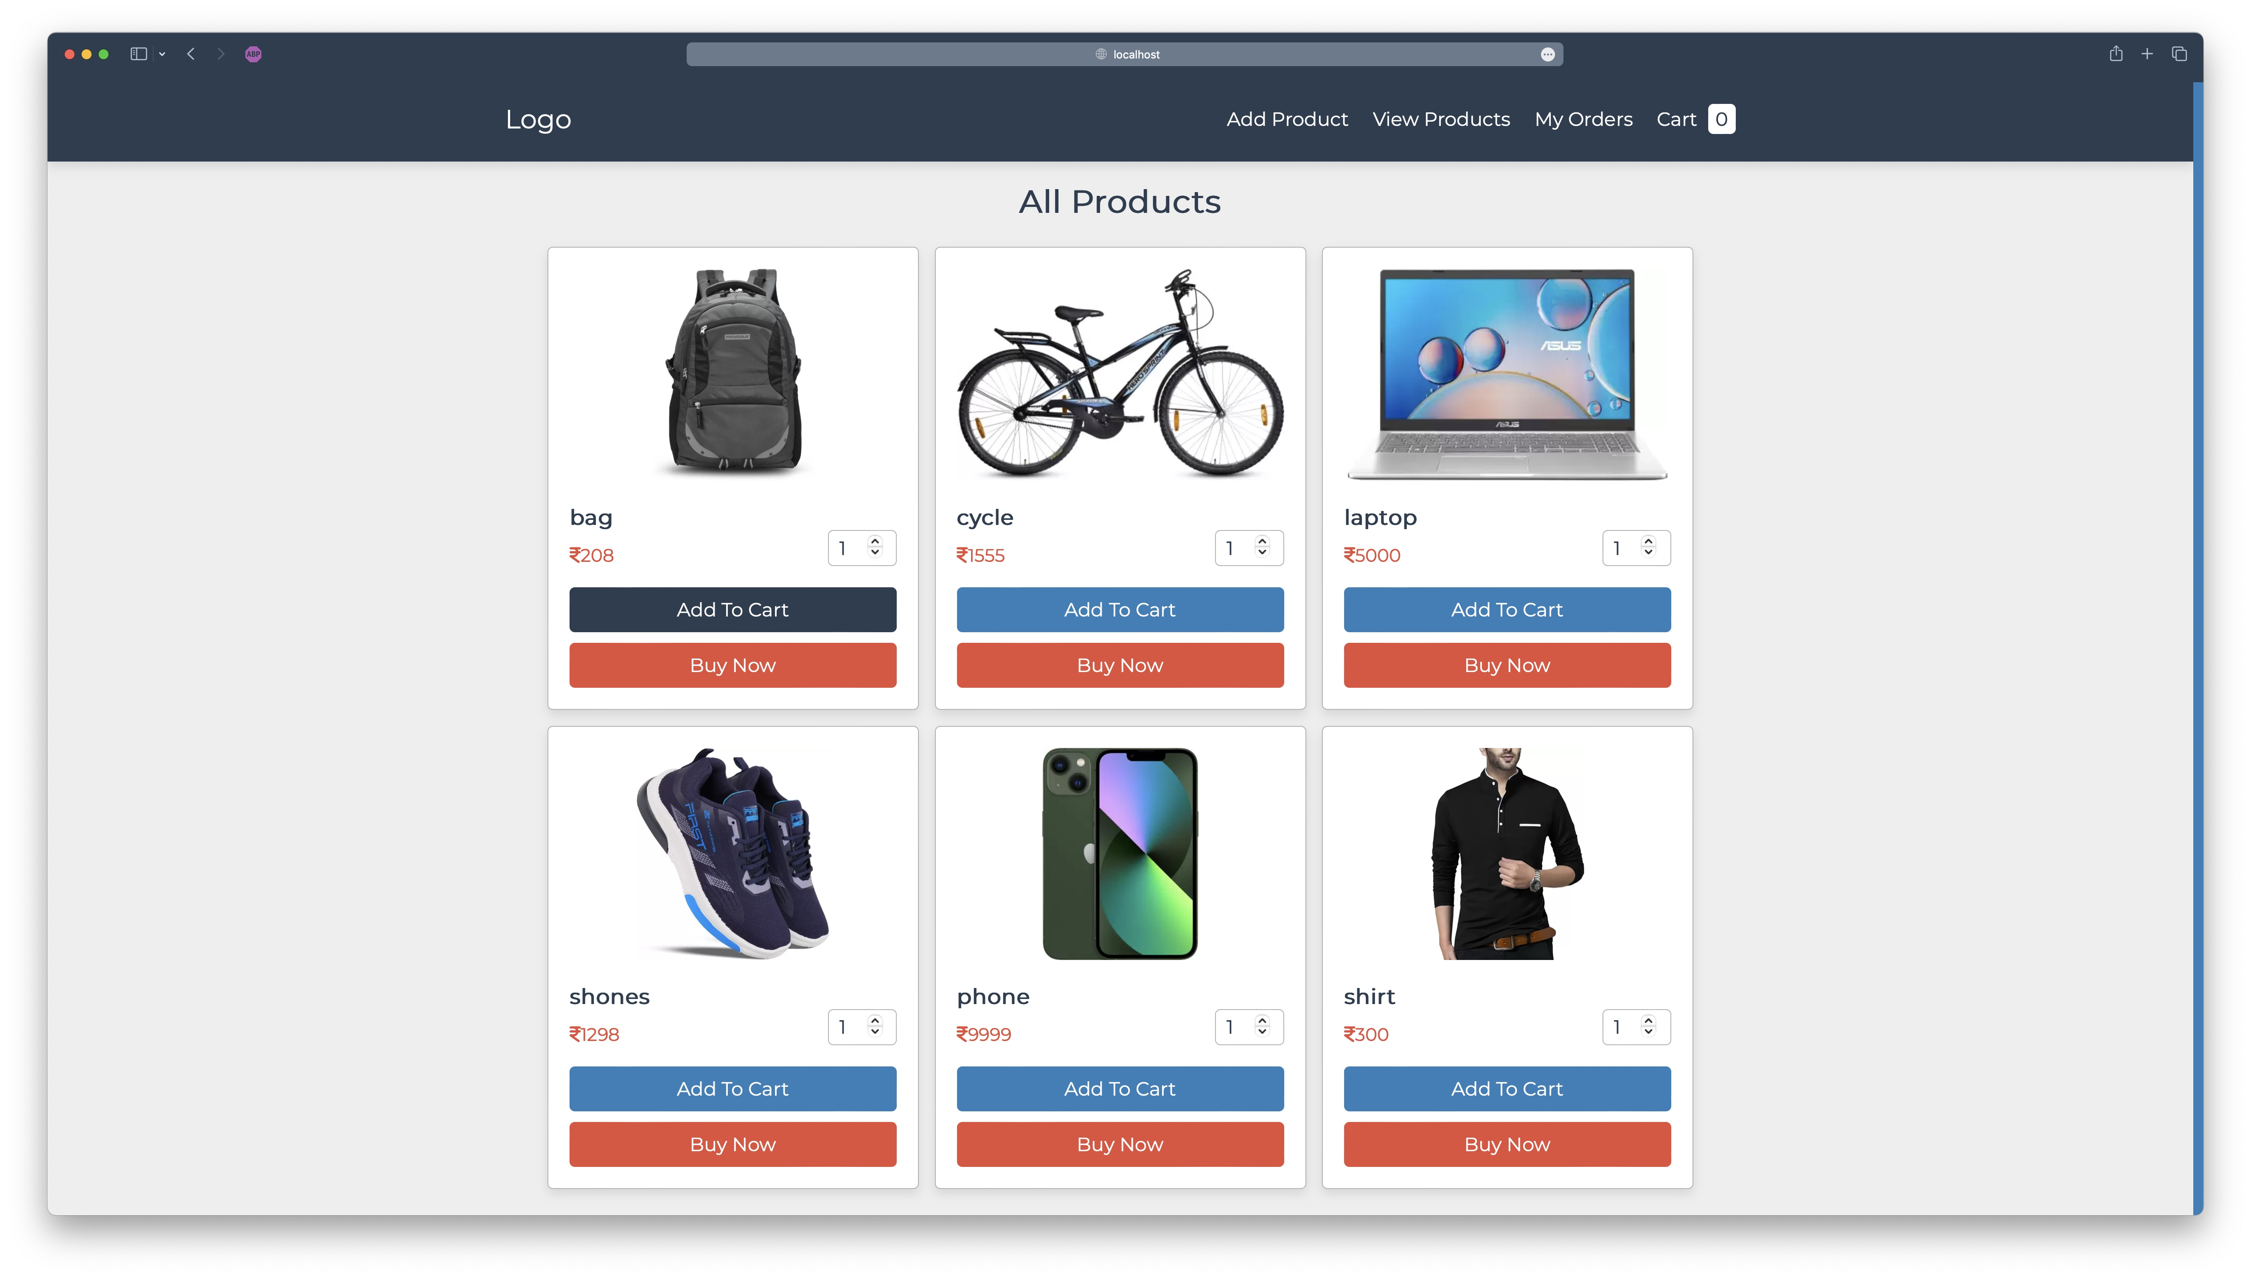
Demo
Secure
Show all the products in one page

Slide 11
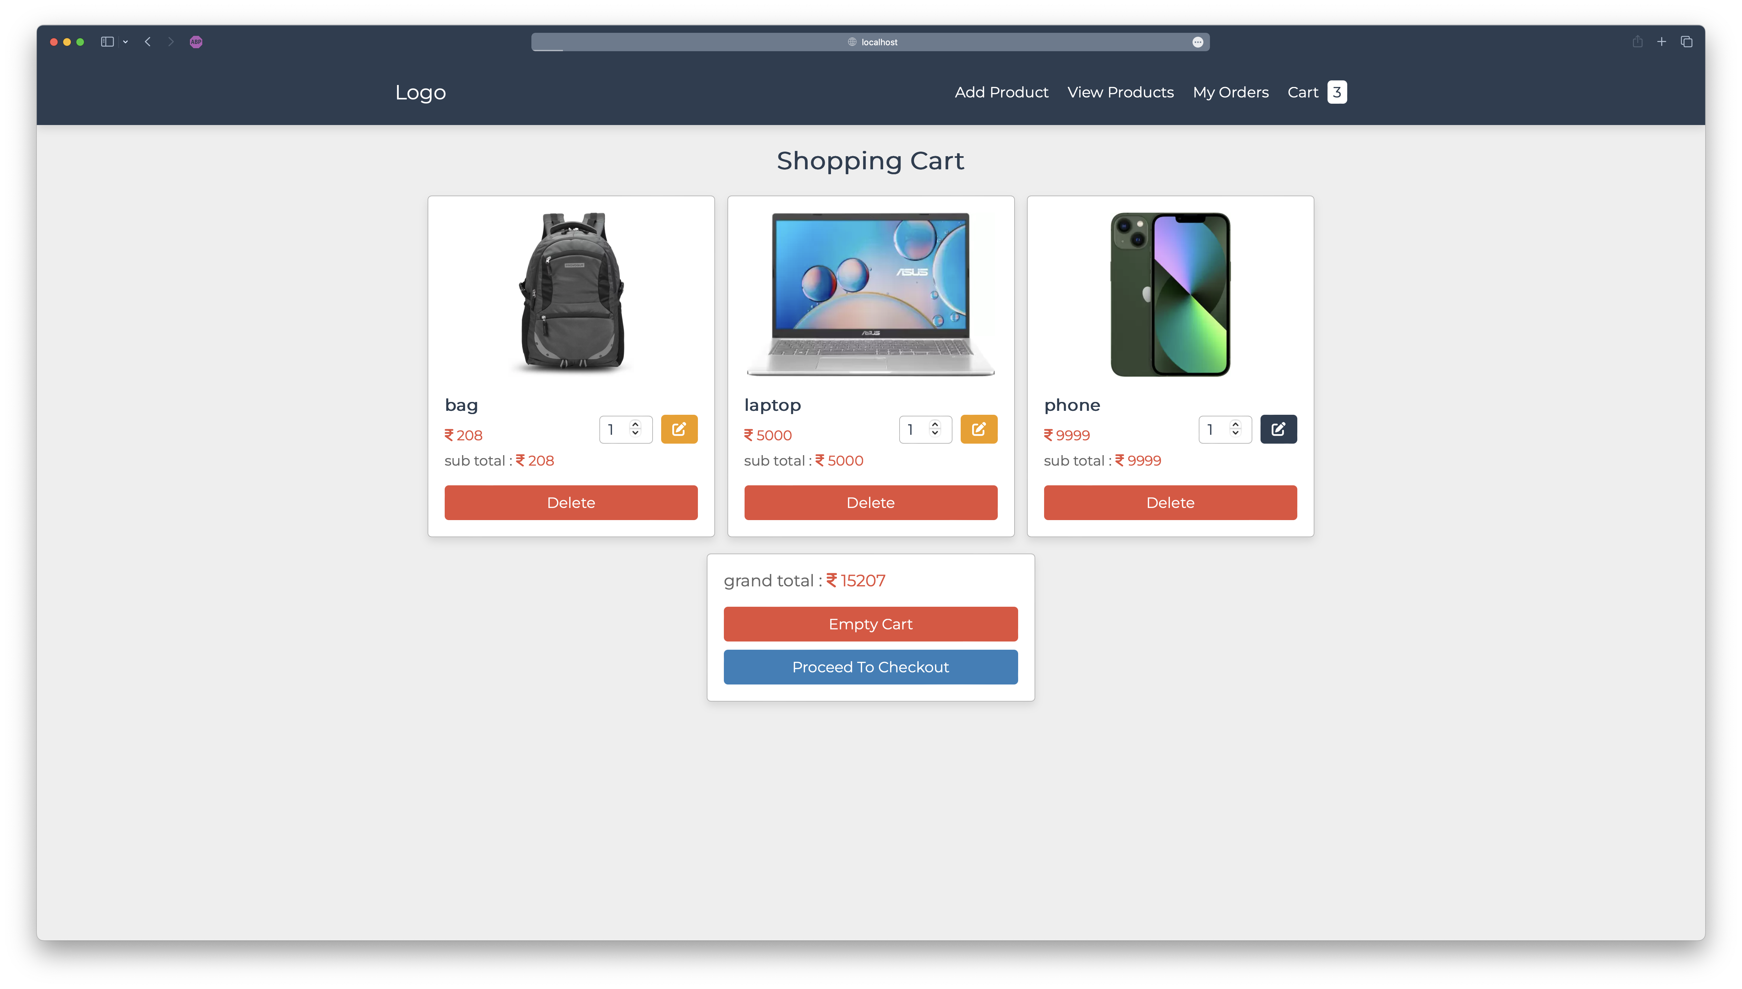
Demo
Show all the products chosen

Slide 12
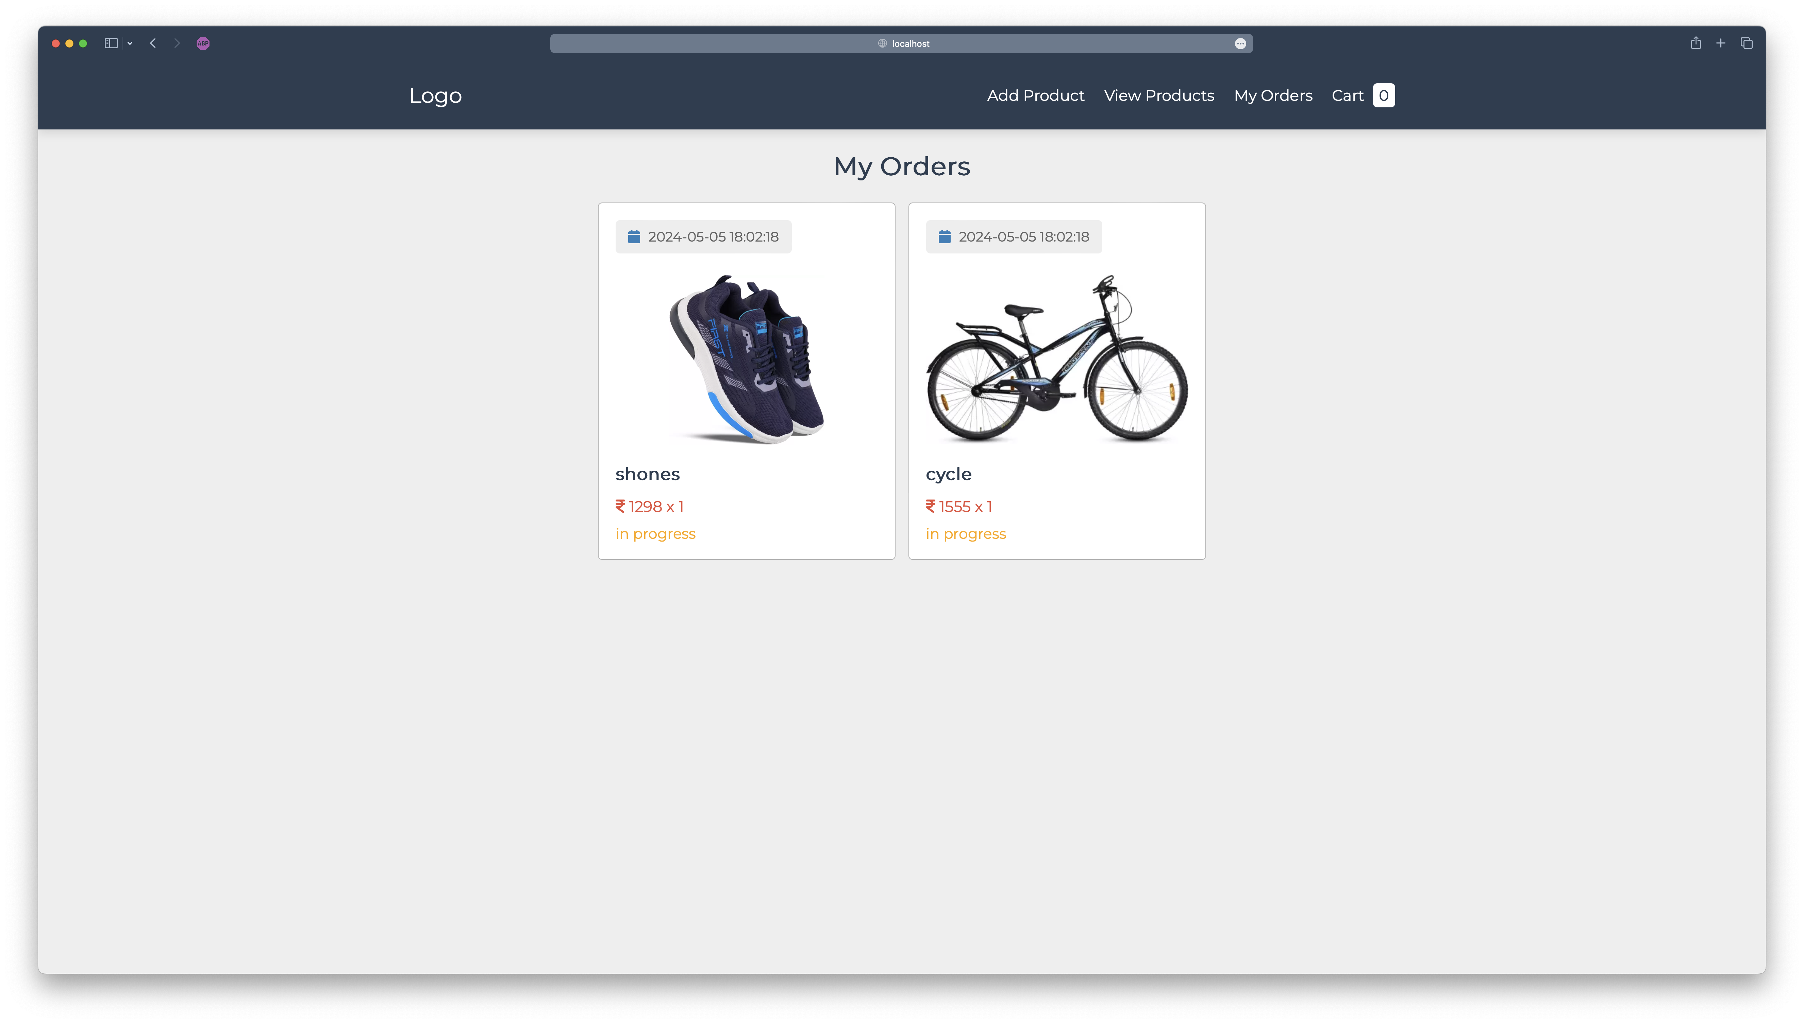
Demo
Track the delivery’s progress and provide more details

Slide 13
THANK YOU !

